Slide 1
SQL-1

Slide 2
SQL Characteristics
Free form language, statement terminated with semi-colon ;
•
–
Select empno, empame from employee ..
vs
Select
empno, empname
from
–
employee ….
(preferred style, more readable)
•
Most components are case insensitive
–
–
SElECT vs select
Important exception when searching for a value
•
literal character data must match the exact case in the database
– SMITH vs smith vs Smith (all different database values)
•
Data representation in SQL commands
–
–
Non numeric data must be enclosed in single quotes - 'Smith'
Numeric data must not be enclosed in quotes - 12345
5

Slide 3
SELECT statement
Is used to query the database and retrieve selected data that match the criteria that you specify
•
•
In
its
–
simplest form a SELECT statement must include the following:
A SELECT clause, which specifies the columns to be displayed
–
A FROM clause, which specifies the table columns listed in the SELECT clause
containing
the
SELECT [DISTINCT] {*, column [alias],...}
FROM table;
6

Slide 4
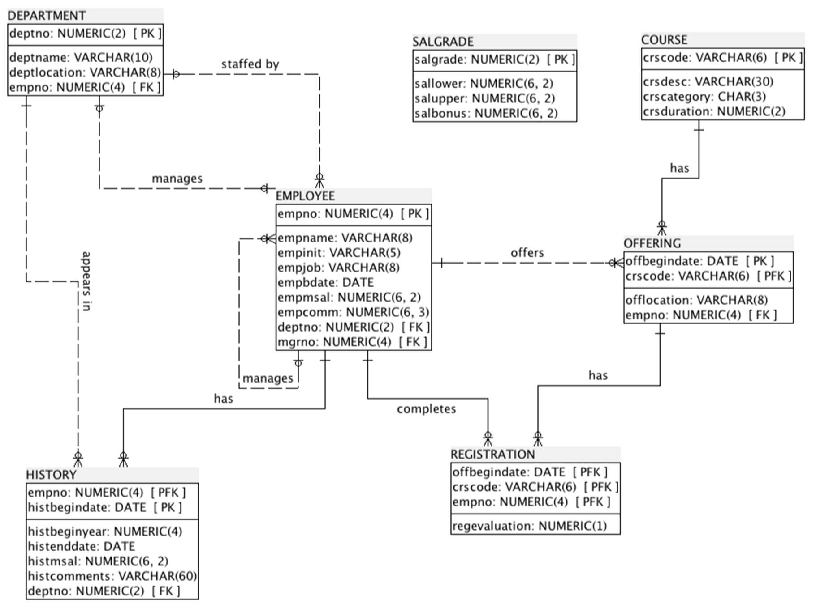
Employee
Logical
Model
8

Slide 5
SELECT statement
SELECT * FROM employee;
SELECT empname, empjob
FROM employee;
SELECT DISTINCT deptno
FROM employee;
SELECT DISTINCT deptno,
FROM employee;
empjob
SELECT DISTINCT deptno,
FROM employee;
empjob, empmsal
SELECT empname AS "Employee", empmsal AS "Monthly Salary", empcomm
FROM employee;
- note AS is optional (but recommended)
10

Slide 6
WHERE clause
restricts the rows returned from the query contains a condition that must be met directly follows the FROM clause
•
•
•
•
can compare values
or functions
in columns, literal values, arithmetic
expressions,
SELECT
FROM [WHERE
[DISTINCT] {*, column
table condition(s)]
[alias],...}
•
consists of three
elements
–
–
–
Column name
Comparison operator
Column name, constant, or list of values
11

Slide 7
Comparison operators
Comparison operators
•
–
are used in conditions that compare one expression
to
another
Syntax:
… WHERE expr
operator
value
=
>
<
>=
<=
<>
Equal
Greater than Less than Greater than Less than or Not equal to
or equal
equal
12

Slide 8
Comparison operators
SELECT empname, mgrno, deptno, empjob
FROM employee
WHERE empjob = 'TRAINER';
SELECT empname, mgrno, deptno, empjob
FROM employee
WHERE empjob = 'Salesrep';
vs WHERE empjob = 'SALESREP'
SELECT empname, mgrno, deptno, empjob
FROM employee
WHERE deptno = 20;
Note in the following two selects empbdate is a date, '31-DEC-1965' and '01/12/1965' are strings:
SELECT empname, empbdate, mgrno, deptno, empjob
FROM employee
WHERE empbdate < '31-DEC-1965';
SELECT empname, empbdate, mgrno, deptno, empjob
FROM employee
WHERE empbdate > '01/12/1965';
Success depends on Oracle 'standard' date format, unless conversion functions are used - we will return to this
SELECT empname, mgrno, deptno, empjob, empmsal
FROM employee
WHERE empmsal >= 1250;
13

Slide 9
Special operators (LIKE)
• LIKE Operator
–
–
–
Used in the WHERE clause in combination with a search pattern
% A percent sign before or after the LIKE operator means zero, one, or more arbitrary characters
_ An underscore before or after the LIKE operator means exactly one arbitrary character
SELECT empname, mgrno, deptno, empjob, empmsal
FROM employee
WHERE empname LIKE 'S%';
SELECT empname, mgrno, deptno, empjob, empmsal
FROM employee
WHERE empname LIKE '%N';
SELECT empname, mgrno, deptno, empjob, empmsal
FROM employee
WHERE empname LIKE '_A%';
15

Slide 10
Special operators (IN, NOT IN)
• IN operator
– Used in the WHERE clause to compare a column expression against a list of values
SELECT empname, mgrno, deptno, empjob, empmsal
FROM employee
WHERE empjob IN ('TRAINER', 'MANAGER');
SELECT empname, mgrno, deptno, empjob, empmsal
FROM employee
WHERE mgrno NOT IN (7698, 7839);
16

Slide 11
Special operators (IS NULL, IS NOT NULL)
• IS NULL operator
–
–
Used in the WHERE clause to check whether an attribute is null
Only has one operand: the preceding column name or column expression
SELECT empname, mgrno, deptno, empjob, empmsal
FROM employee
WHERE empcomm IS NULL;
Note you cannot use = to test for a null
SELECT empname, mgrno, deptno, empjob, empmsal
FROM employee
WHERE empcomm = NULL;
will return no rows, but not an error (it is syntactically correct)
SELECT empname, mgrno, deptno, empjob, empmsal
FROM employee
WHERE empcomm IS NOT NULL;
17

Slide 12
Special operators (BETWEEN, NOT BETWEEN)
BETWEEN operator
•
–
Used in the WHERE clause to check whether an attribute a range of values (inclusive)
value
is
within
SELECT empname, mgrno, deptno, empjob, empbdate
FROM employee
WHERE empbdate BETWEEN '10-JAN-50' AND '26-NOV-59';
SELECT empname, mgrno, deptno, empjob, empmsal
FROM employee
WHERE empmsal NOT BETWEEN 1500 AND 2500;
Note values in between clause must be in ascending order:
SELECT empname, mgrno, deptno, empjob, empmsal
FROM employee
WHERE empmsal BETWEEN 1500 AND 1250;
will return no rows, but not an error (it is syntactically correct)
18

Slide 13
Logical operators
AND operator
•
–
requires both conditions to be TRUE
SELECT empname, mgrno, deptno,
FROM employee
WHERE deptno = 30
AND empjob = 'SALESREP';
empjob,
empmsal
SELECT empname, mgrno, deptno,
FROM employee
WHERE deptno = 30
AND empjob = 'SALESREP' AND empbdate < '01-JUN-65';
empjob,
empmsal,
empbdate
20

Slide 14
Logical operators
• OR operator
–
requires either condition to be TRUE
SELECT empname, mgrno, deptno,
FROM employee
WHERE deptno = 30
OR empjob = 'SALESREP';
empjob,
empmsal
SELECT empname, mgrno, deptno,
FROM employee
WHERE deptno = 30
OR empjob = 'SALESREP' OR empmsal < 1500;
empjob,
empmsal,
empbdate
21

Slide 15
Logical operators
• NOT operator
–
Can be applied to any arbitrary condition to negate that condition
SELECT empname, mgrno, deptno, empjob,
FROM employee
WHERE NOT deptno = 30;
empmsal,
empbdate
SELECT empname, mgrno, deptno, empjob,
FROM employee
WHERE NOT empbdate < '01-JAN-65';
empmsal,
empbdate
22

Slide 16
Rules of Precedence
• When writing an SQL query using operators it is important to be
aware of how the query
is
evaluated
ORDER EVALUATED
1
2
3
4
OPERATOR
ALL Comparison
NOT AND OR
Operators
• To override
the order of
precedence use parentheses around
the
clauses – suggest always use to clarify requirement
23

Slide 17
Arithmetic Operators
Can be applied to NUMBER values and to some extent DATE values
SELECT empname, empmsal, empmsal*12 as "Annual Salary"
FROM employee;
If you subtract two DATE values you get the difference between the two dates in days (SYSDATE is an Oracle function which returns the current system date)
SELECT empname, empbdate, SYSDATE - empbdate as "Age in
Days"
FROM employee;
SELECT empname, empbdate, (SYSDATE - empbdate)*24 as "Age
Hours"
FROM employee;
You can add a DATE and an INTERVAL value, which results in another date
SELECT empname, empbdate, empbdate + INTERVAL '10'
YEAR FROM employee;
•
•
in
•
25

Slide 18
Arithmetic with Dates
–
If you add or subtract a DATE and a NUMBER, the number is
interpreted as an interval expressed in days
SELECT empname, empbdate, empbdate + 365
FROM employee;
•
•
The DATE data type stores date and time information
Oracle stores dates in an internal numeric format: century, year, day, hours, minutes, seconds.
SYSDATE is a function that returns the current date and time.
month,
•
•
DUAL is a dummy table used to view SYSDATE.
SELECT SYSDATE FROM dual;
26

Slide 19
Nulls in Arithmetic Expressions
Problem - arithmetic expressions containing a null value evaluate null:
SELECT empname, empmsal, empcomm,
12*empmsal+empcomm as "Annual Salary"
FROM employee;
NVL function
•
to
•
–
The NVL function forces arithmetic operators to include
values and replace the null with the listed value
null
SELECT empname, empmsal, empcomm,
12*empmsal+NVL(empcomm,0) as "Annual Salary"
FROM employee;
NVL(expr, y)
•
if expr is NULL, returns y;
otherwise returns expr
27

Slide 20
Concatenation Operator (||)
SQl supports one alphanumeric operator that allows you to concatenate string expressions
•
•
Concatenates columns or character strings to
columns
Is represented by two vertical bars (II)
Creates a resultant column that is a character
other
•
•
expression
SElECT empinit II empname
FROM employee;
28

Slide 21
Literal Character Strings
A literal is a character, expression, or number included in the SElECT
list.
SELECT 'Employee ' II empname II ' is number ' II empno
FROM employee;
•
•
•
Character literal values must be enclosed within single quotation
marks.
Each character string is output once for each
SELECT empname II ' is a ' II empjob
FROM employee;
row
returned.
29

Slide 22
ORDER BY
The order of rows returned in a query result is undefined
•
–
Week 3 – property of relational model "Tuples are unordered
within a relation"
•
The ORDER BY clause must always be used to sort the rows
(unless
you are sure there
is
only a single row returned)
SELECT
FROM [WHERE
expr
table condition(s)]
[ORDER BY {column, expr} [ASC|DESC]];
ASC
–
•
orders the rows in ascending order (this is the default
order)
–
DESC
•
orders the rows in descending order
30

Slide 23
ORDER BY
SElECT empname, mgrno,
FROM employee
WHERE deptno = 30
ORDER BY empjob;
deptno, empjob,
empmsal,
empbdate
SElECT empname, mgrno,
FROM employee
deptno, empjob,
empmsal,
empcomm
ORDER
–
BY deptno, empcomm;
How
•
•
do we treat NUll values when
sorting?
Always as first values or last values (regardless of sorting order)?
As low or high values?
–
What is ORAClE's default behaviour for sorting NUlls?
SElECT empname, mgrno, deptno, empjob, empmsal, empbdate
FROM employee
ORDER BY deptno, empjob, empmsal DESC;
31

